Slide 1
Denavit –Hartemberg
https://www.youtube.com/watch?v=qiF4HSKplcs
https://www.youtube.com/watch?v=9SefNzyhigQ
https://www.youtube.com/watch?v=8qkLtNMibds&t=937s
https://www.youtube.com/watch?v=mbAhA3w8UEA

Slide 2
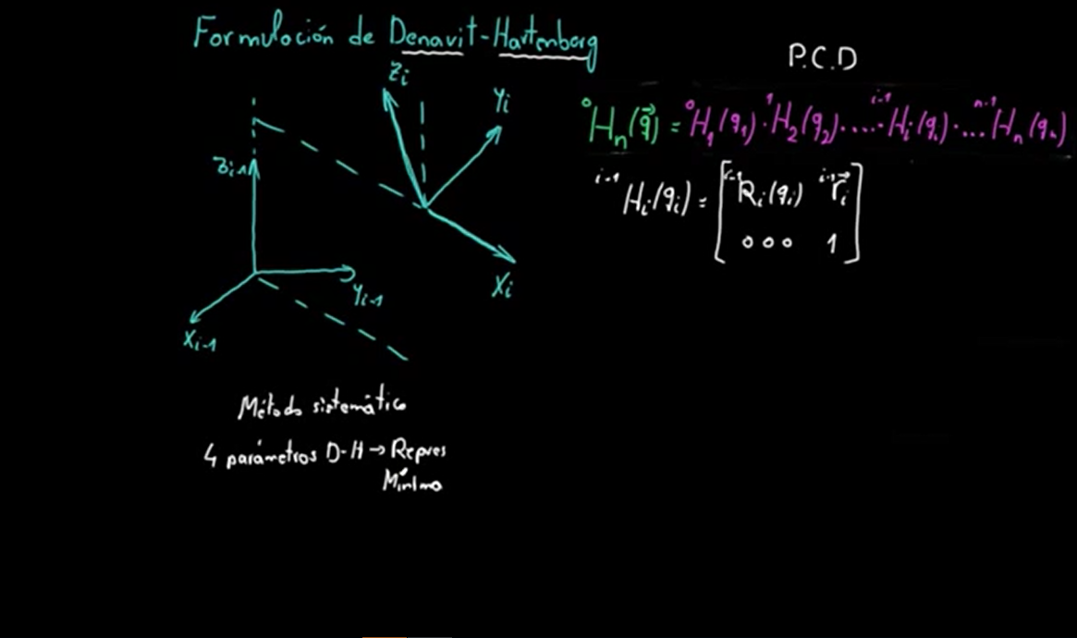

Slide 3
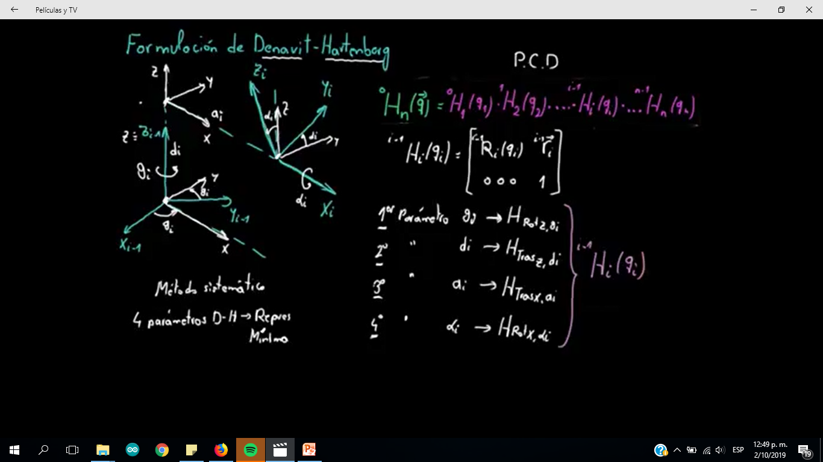

Slide 4
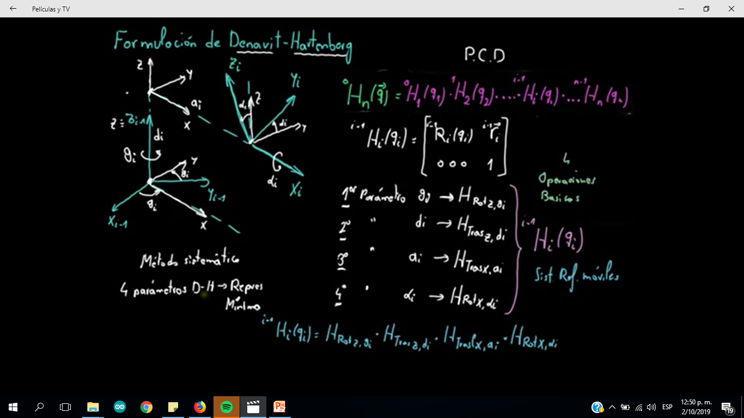

Slide 6
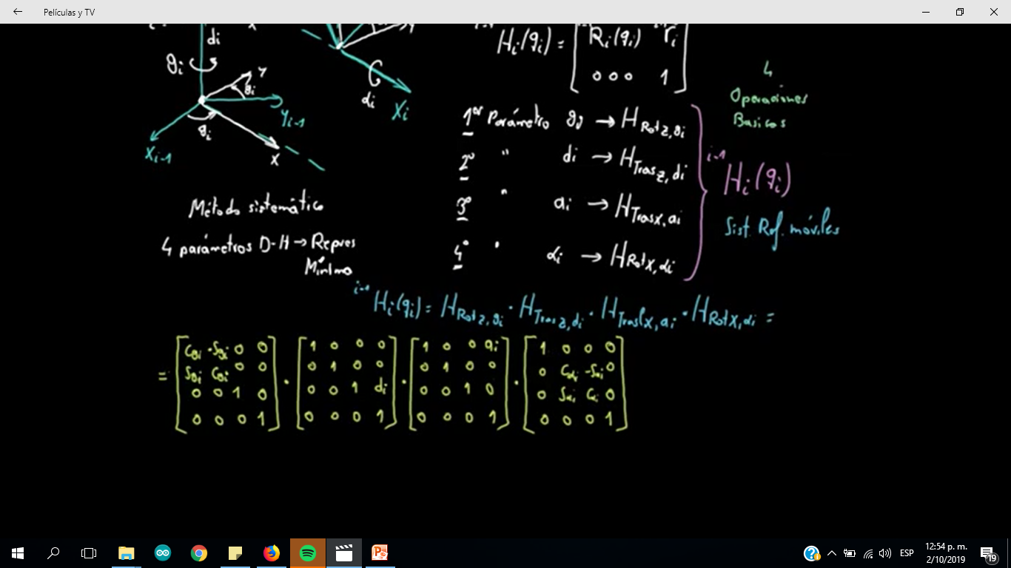

Slide 12
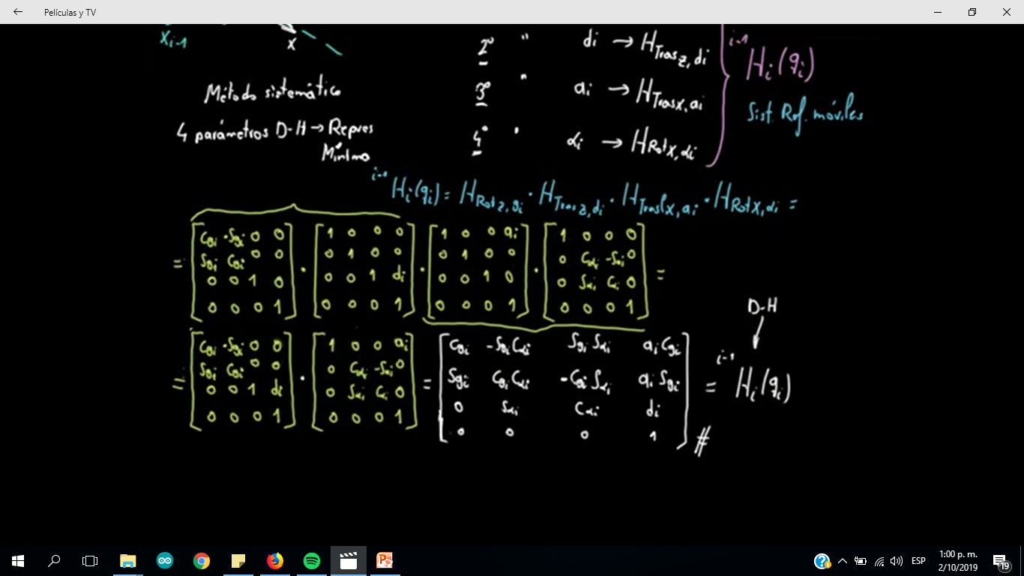

Slide 14
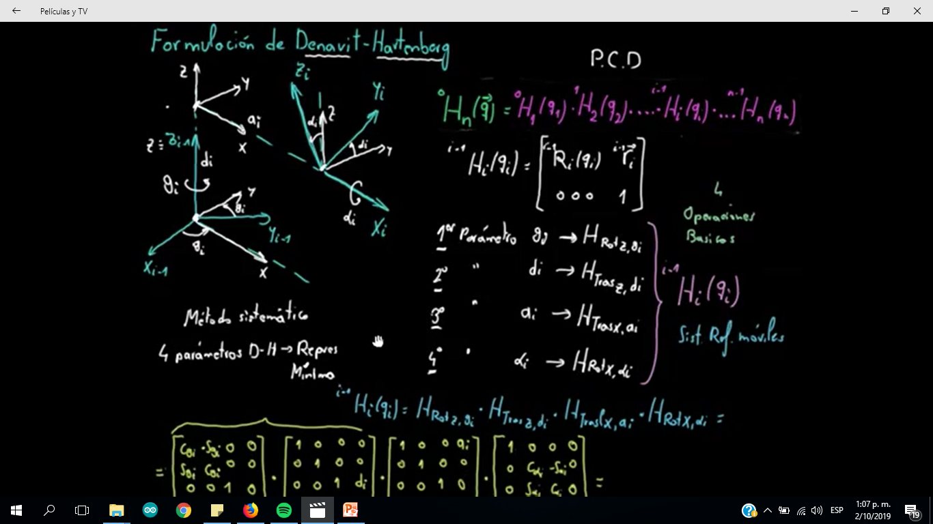

Slide 15
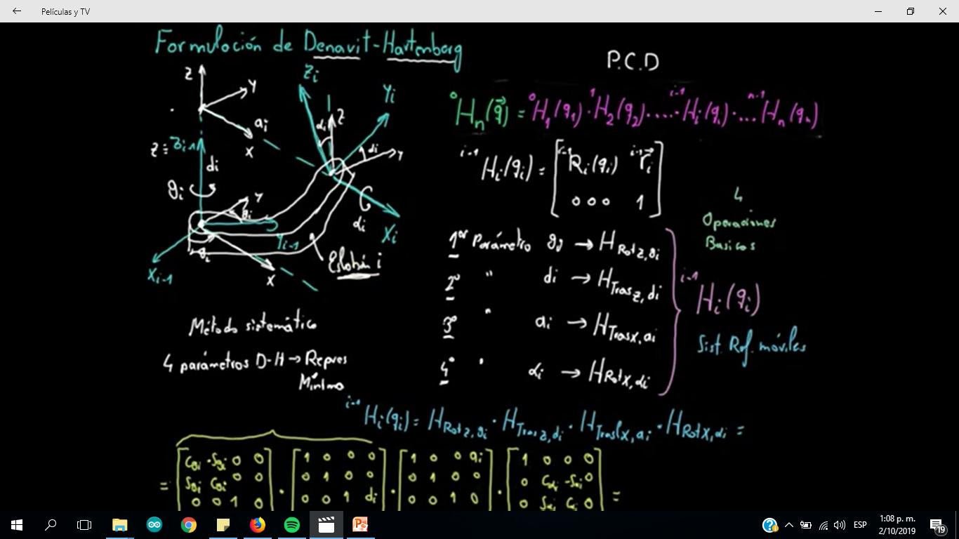

Slide 16
